Slide 1
Users, Groups, and Permissions in Linux

Slide 2
Agenda
Creating and modifying users
Creating and modifying groups
File permissions

Slide 3
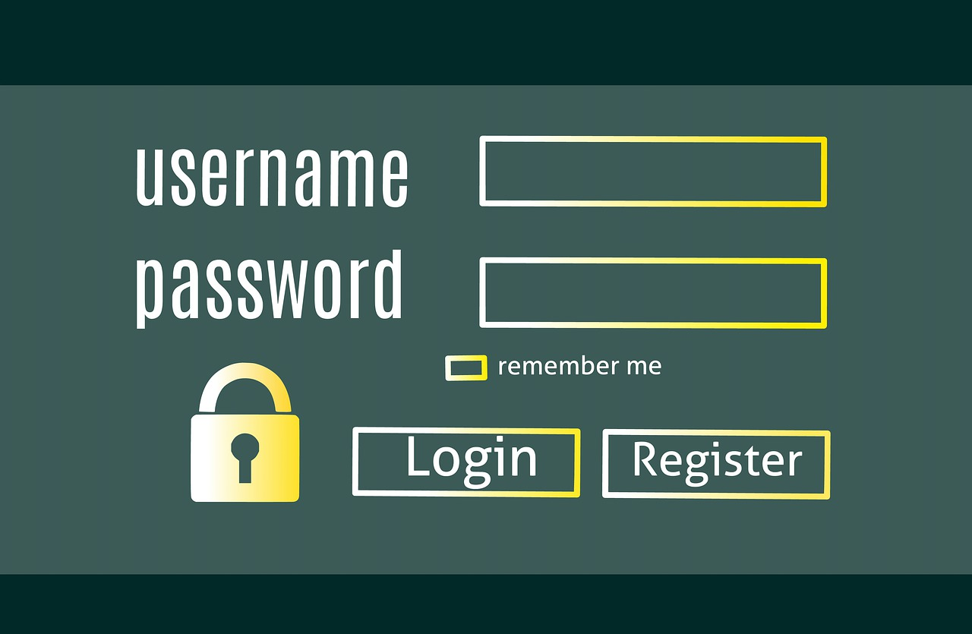
useradd Vs adduser
adduser – will create a new user and request some information about the user
useradd – will create a new user with defaults and NO PASSWORD

Slide 4
passwd
The file /etc/passwd contains information about our users, but interestingly NOT their password
passwd is a command that we can use to set or change the password of a user

Slide 5
usermod
This is the PROPER way to modify a user.
Technically you *can* (… and I sometimes do) edit /etc/passwd, /etc/shadow, /etc/group… with a text editor, but you really shouldn’t.

Slide 6

userdel
If usermod modifies a user what do you thing userdel does?
https://www.marvel.com/characters/thanos/on-screen/profile

Slide 7

groups
The groups command will list all the groups a user is a member of.
If no user is specified it will
assume the current user

Slide 8
groupadd Vs addgroup
Just like useradd and adduser addgroup will create a new group after requsting information and groupadd will simply create a new group.
Fun fact: both adduser and addgroup really call useradd and groupadd in the end.

Slide 9
groupmod and groupdel
Modify and delete groups just like their counterparts usermod and userdel modify and delete users.
Again, you *can* edit the configuration files directly, but you really shouldn’t

Slide 10
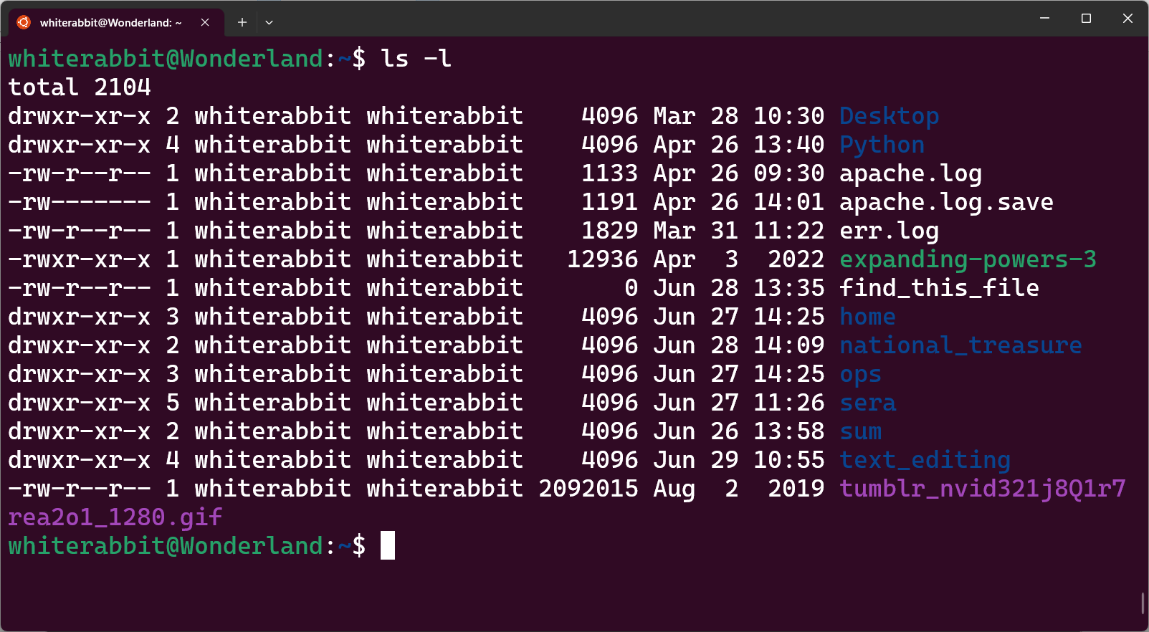
chmod
Change Mode – this is used to set file permissions
r – read
w – write
x - execute

Slide 11
File Permissions Math
-rwxrwxrwx
Each permission is controlled by a single bit (1,0)
Permissions are separated as Owner, Group, World
111 101 001 – what permissions are represented?
7 5 1

Slide 12
Using chmod
We can specify the value for the permissions we want
  chmod 777
    Please try to avoid granting 777 permissions -_-
We can add or remove permissions symbolically
  chmod +rwx
    Seriously avoid granting this much permission
We should always keep in mind the Principle of least privilege

Slide 13
Using chmod
User who owns it (u)
File's group (g)
Other users not in the file's group (o)
all users (a)
EXAMPLE chmod o-rw

Slide 14
setuid, setgid, and eww stickybits
setuid – This will set the file to execute as the owner of the file
setgid – This will set the file to execute as the group on the file
sticky bit – If this permission is set it protects the file from deletion

Slide 15

But wait where are uid,gid, and the sticky bit stored?!?!
Good catch! There is a secret 3rd set of bits before the standard permission where uid is 4 guid is 2 and the sticky bit is 1

Slide 16

I need information stat
stat is a useful utility that shows us the current status of a given file.

